Slide 1
Car Price Prediction Analysis

Slide 2
Introduction
This Project involves the Prediction of Car prices
The XYZ is a new company in the Market and They need Analysis on the Prices so they can better design and compare with the market.
This prediction not only helps them to compete with market but also provides the best selling rates and features.

Slide 3
Stages In Development of the App
Investigation
Dataset collection
Training and Testing the best models
Deployment

Slide 4
Stage 2 Data Gathering

Slide 5
Environment Setup
Google Colab was chosen for the development environment.
The scikit-learn was used as the main library for the Machine learning models.

Slide 6
Data Acquisition
The dataset was acquired from Kaggle, a platform providing competitive and educational data science datasets.
The dataset was downloaded using the Kaggle API commands.
!kaggle datasets download -d deepcontractor/car-price-prediction-challenge/ ! unzip "car-price-prediction-challenge.zip"

Slide 7
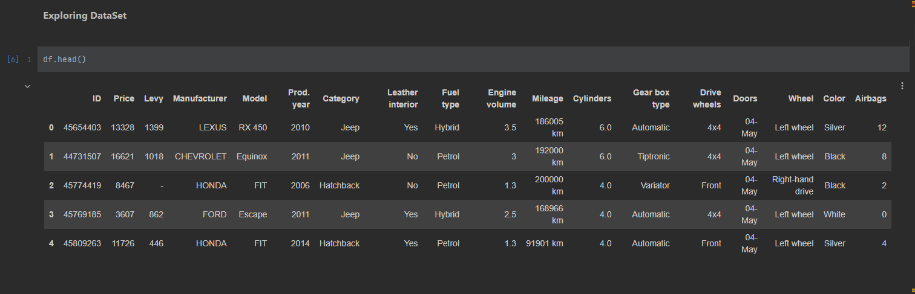
Exploring DataSet

Slide 8
Stage 3 Data Cleaning and Preprocessing

Slide 9
Data Cleaning Steps
The missing values are being checked and removed
The repeating values are being checked and removed
Drop Columns that are not providing the information like ID
Striping the Km from the mileage because we want to standard the unit distance to km.
We also need to check the Age of the car so created the new column
LabelEncoder for converting labels into a numeric format.
obdata = df.select_dtypes(include=object) numdata = df.select_dtypes(exclude=object) for i in range(0,obdata.shape[1]): obdata.iloc[:,i] = lab.fit_transform(obdata.iloc[:,i]) df = pd.concat([obdata,numdata],axis=1) print(df)

Slide 10
Data Visualization

Slide 11
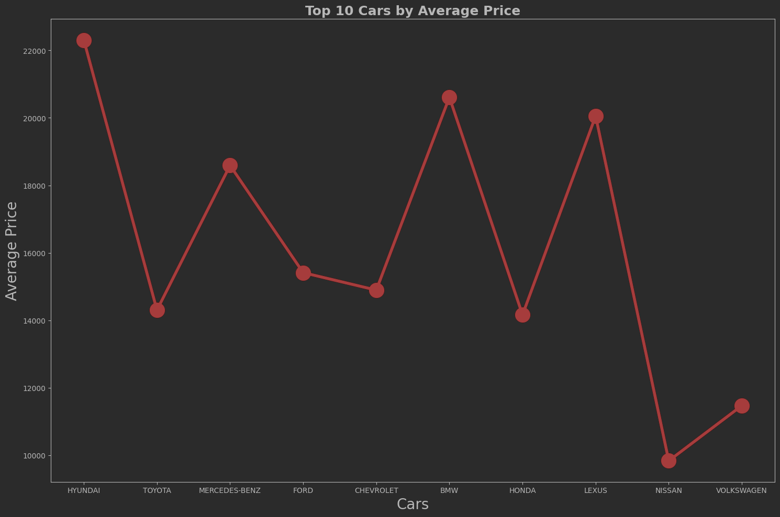
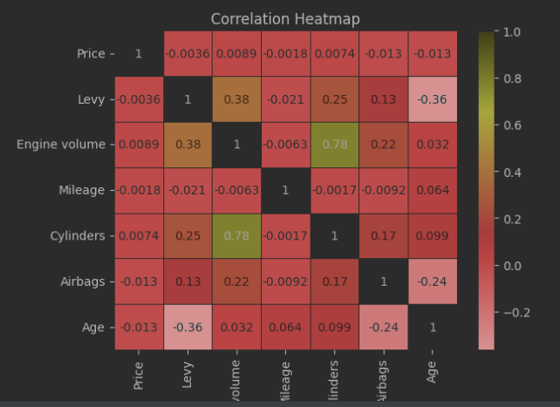
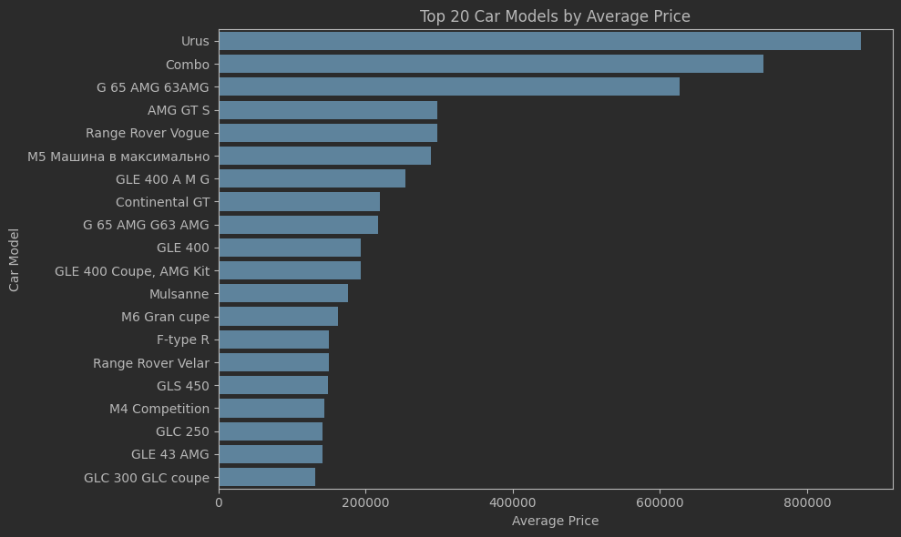
Enhancing Understanding Through Visuals
Scatter plots were used to identify relationships between continuous variables. Box plots helped in detecting outliers in the data.
Python libraries like matplotlib and seaborn are used for visualization
Visualization of price versus horsepower revealed a strong positive correlation, indicating that as horsepower increases, so does the price.

Slide 12
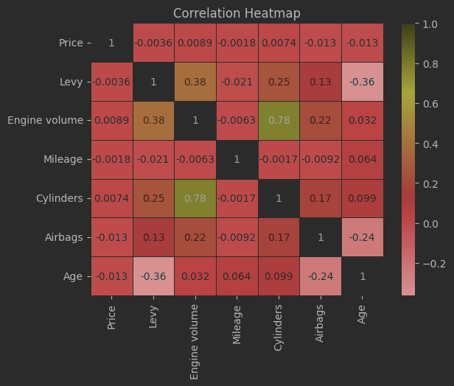
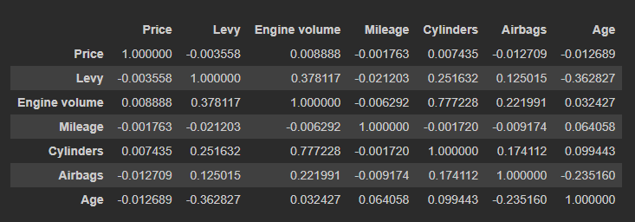
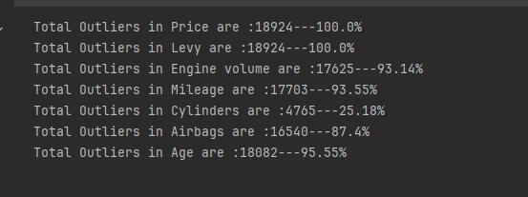
Outlier Detection and Correlation Analysis
Outlier detection is the process of identifying data points that are far away from the average.
Correlation analysis is a statistical method that measures the strength and direction of a linear relationship between two or more variables

Slide 13
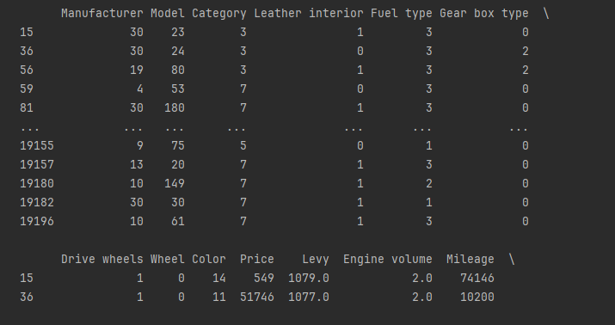
Transformation of Data into Numeric Formats
numeric formats is crucial for machine learning models, which primarily operate on numerical input.
the use of pandas functions select_dtypes(include=object) and select_dtypes(exclude=object) to segregate the dataset into object-type and numeric-type data.
obdata = df.select_dtypes(include=object) numdata = df.select_dtypes(exclude=object) for i in range(0,obdata.shape[1]): obdata.iloc[:,i] = lab.fit_transform(obdata.iloc[:,i]) df = pd.concat([obdata,numdata],axis=1) print(df)

Slide 14
Model Training and Evaluation

Slide 15
To develop a model capable of accurately predicting car prices based on the features identified and prepared in earlier stages.
9 Models was used in this Training Process
LinearRegression, Ridge, Lasso, ElasticNet, DecisionTreeRegressor, SVR, RandomForestRegressor GradientBoostingRegressor, AdaBoostRegressor.

Slide 16
Model Evaluation Metrics
Mean Squared Error (MSE) measures the average squared difference between the predicted values by the model and the actual values.
Mean Absolute Error (MAE) measures the average of the absolute differences between the predicted values and the actual values.pen_sparkexpand_more
R-squared (R²) represents the proportion of variance in the target variable that's explained by the model.

Slide 17
Cross-Validation
K-fold cross-validation is a technique used to evaluate a model's generalizability. In simpler terms, it helps us assess how well a model trained on a specific dataset will perform on unseen data.
In K-Fold Cross-Validation the entire dataset is divided into k equal folds.
Iterative Training and Testing: In each iteration (round), one fold is designated as the testing set and the remaining k-1 folds are combined to form the training set.
This process of training, testing, and evaluating is repeated for all k folds. Each fold gets a chance to be the testing set once.
# Define K-Fold cross-validation kf = KFold(n_splits=10, shuffle=True, random_state=42) # Function to perform cross-validation and calculate mean of scores def evaluate_model(model, X, y, scoring): scores = cross_val_score(model, X, y, cv=kf, scoring=scoring) return scores.mean() model_performance = [] # Train and evaluate each model using cross-validation for model in models: mse = evaluate_model(model, x_train, y_train, make_scorer(mean_squared_error, greater_is_better=False)) r2 = evaluate_model(model, x_train, y_train, make_scorer(r2_score)) mae = evaluate_model(model, x_train, y_train, make_scorer(mean_absolute_error, greater_is_better=False)) model_performance.append((model.__class__.__name__, -mse, r2, -mae)) # Negate MSE and MAE to align with 'higher is better'
# Determine the best model based on averaged scores best_mse = min(model_performance, key=lambda x: x[1]) best_r2 = max(model_performance, key=lambda x: x[2]) best_mae = min(model_performance, key=lambda x: x[3]) # Print the best models based on cross-validated scores print(f"Best model based on Average MSE: {best_mse[0]} with MSE: {best_mse[1]}") print(f"Best model based on Average R2: {best_r2[0]} with R2: {best_r2[2]}") print(f"Best model based on Average MAE: {best_mae[0]} with MAE: {best_mae[3]}")

Slide 18
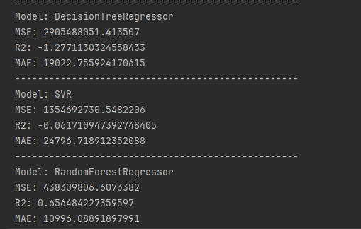
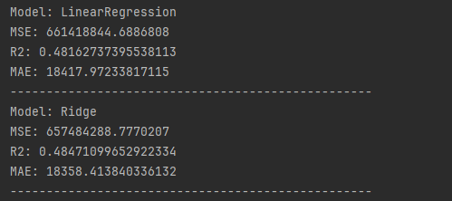
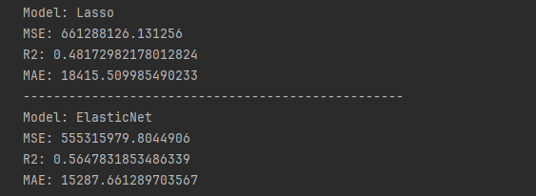
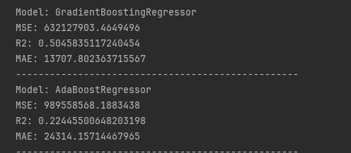
Evaluations

Slide 19
Best Model Selection
The Best Model was the Random Forest Regressor with the MSE 438309806.6073382

Slide 20
Deployment Stage

Slide 21
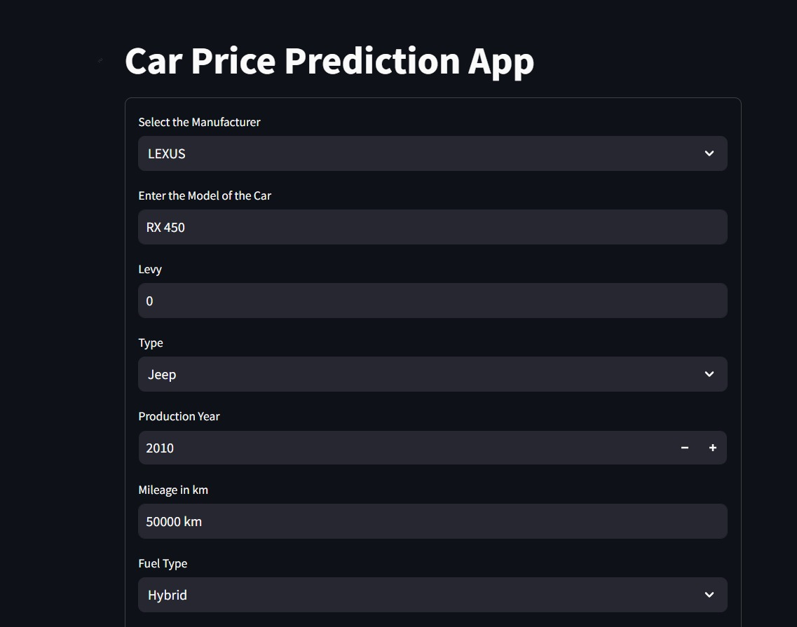
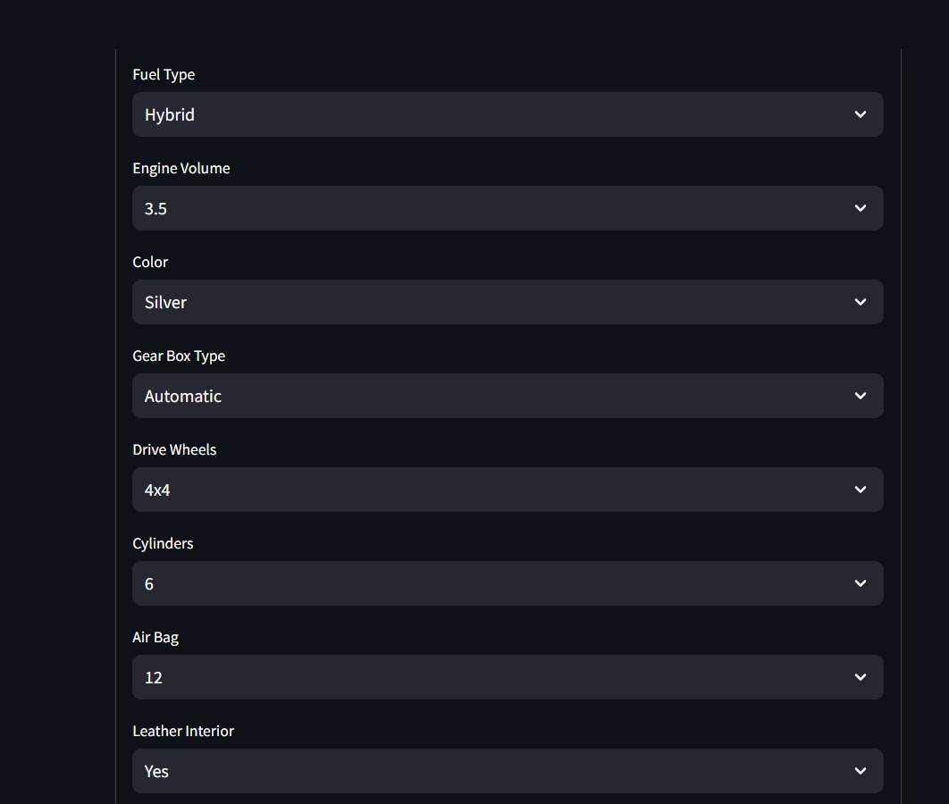
Stream Lit Deployment

Slide 22
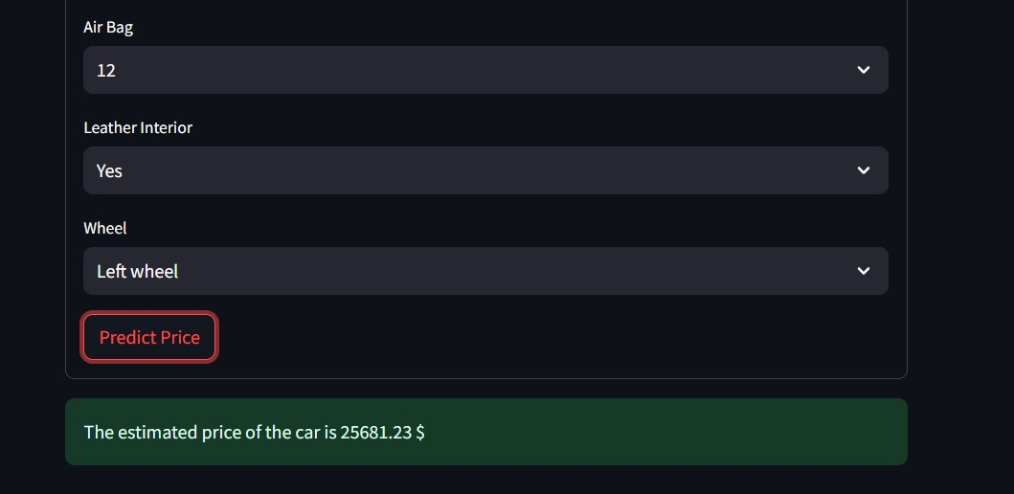
Cont…

Slide 23
The End

